Slide 1
Network Traffic Analysis Using Wireshark & Zeek
Submitted by : KARAN YADAV Course : Cybersecurity College : ABESIT Date :

Slide 2
Abstract
what problem does this project solves ?
This project focuses on identifying security threats and unusual activities in network traffic. The problem it solves is that many cyberattacks and network issues go unnoticed because traditional tools either look too narrowly or don’t provide enough detail. This project addresses the problem of detecting malicious activities, performance bottlenecks, and anomalies within network traffic by leveraging packet-level and flow-level analysis. Traditional security measures often struggle with identifying subtle threats hidden within legitimate traffic or providing comprehensive visibility into network behavior.

Slide 3
How is it solved
To tackle this issue, we implemented a dual-framework approach utilizing Wireshark for deep packet inspection and Zeek for real-time network monitoring and log-based analysis. Wireshark was employed to capture and inspect individual packet data, enabling detailed examination of packet headers and payloads for suspicious patterns. Concurrently, Zeek was deployed to passively monitor network traffic and generate comprehensive logs, which were subsequently analyzed for anomalies such as unusual connection attempts, protocol misuse, and potential indicators of compromise.

Slide 4
Key result or finding from project
The key result showed that using both tools together was much more effective than using either one alone. We were able to detect hidden issues like strange DNS requests and unauthorized access attempts that might have been missed otherwise. This approach improves the way networks can be monitored and secured.

Slide 5
Table of Contents
Introduction 1.1 What is the Project About? 1.2 Why This Project? 1.3 Project Overview
Objectives
Methodology 3.1 Tools Used 3.2 Network Traffic Capturing with Wireshark 3.3 Network Traffic Monitoring with Zeek

Slide 6
Analyzing HTTP Traffic with Wireshark Exercise 1-4 conclusion of above exercises
Detecting and Investigating Malware Traffic Exercise 1-5 conclusion of above exercises
Results and Discussion Results Discussion Challenges

Slide 7
Conclusion Did your project solve the problem you aimed to solve?
What did you learn from the project?
Future work
References

Slide 8
Introduction
This project is about analyzing network traffic to detect unusual or suspicious activities using two powerful tools: Wireshark and Zeek. In simple words, it means monitoring the data that travels across a network to check for problems, attacks, or anything abnormal that might harm the system.
We chose this project because in today’s world, most systems and businesses depend on networks for communication and data transfer. Cyberattacks, hacking, and data leaks often happen without anyone noticing until it’s too late. Network traffic analysis is important because it helps detect these threats early and ensures smooth and secure network operations. The problem we’re solving is the difficulty in spotting hidden cyber threats and network issues using normal security tools.

Slide 9
Tools Used
Wireshark: (I) Network protocol analyzer (II) Captures and inspects packets
Zeek: (I) Network analysis framework
(II) Generates logs and detects patterns/ anomalies

Slide 10
Objective
Capture and analyze network traffic in a controlled lab environment using tools like Wireshark and Zeek (formerly Bro). Focus on detecting suspicious patterns, protocol anomalies, and potential intrusions. Create a report on detected threats and explain how they can be mitigated.
Analyze for : (1) Suspicious patterns (2) Protocol anomalies (3) Potential intrusions

Slide 11
Methodology – Environment Setup
Operating System : [Windows 11/Linux Kali] Wireshark: Download and install Wireshark from https://www.wireshark.org/download.html.
Web Browser: Any modern web browser (e.g., Chrome, Firefox) for generating HTTP traffic.

Slide 12
Methodology – Traffic Capture
Using Wireshark : selected active network interface capture traffic for : > HTTP browsing > HTTPS access > FTP login attempts > ICMP requests

Slide 13
Pre-requisites
Basic understanding of networking concepts
Wireshark installed on your computer
A web browser for generating HTTP traffic
Lab Set-up and Tools
Wireshark: Download and install Wireshark from https://www.wireshark.org/download.html.
Web Browser: Any modern web browser (e.g., Chrome, Firefox) for generating HTTP traffic.

Slide 14
Analyzing HTTP Traffic with Wireshark
Introduction
In this project, you'll learn how to use Wireshark to capture and analyze HTTP traffic. HTTP traffic analysis is crucial for understanding web communication, identifying potential security issues, and investigating anomalies in network traffic.

Slide 15
Exercises
Exercise 1: Capture HTTP Traffic
Steps
Open Wireshark.
Select the network interface that connects to the internet.
Click on the "Start Capture" button (the blue shark fin icon).
Open your web browser and navigate to a website that uses HTTP (e.g., http://example.com).
Let the page load completely and then stop the capture in Wireshark by clicking on the red square icon.
Expected Output
A capture file containing network traffic, including HTTP requests and responses.

Slide 16
Exercice 2: Filter HTTP Traffic
Steps
1. In Wireshark, go to the filter bar at the top.
2. Enter the filter http and press Enter.
3. Wireshark Will display only the HTTP Traffic from the capture.
.Expected Output
Displayed HTTP Traffic filtered from the over all capture.

Slide 17
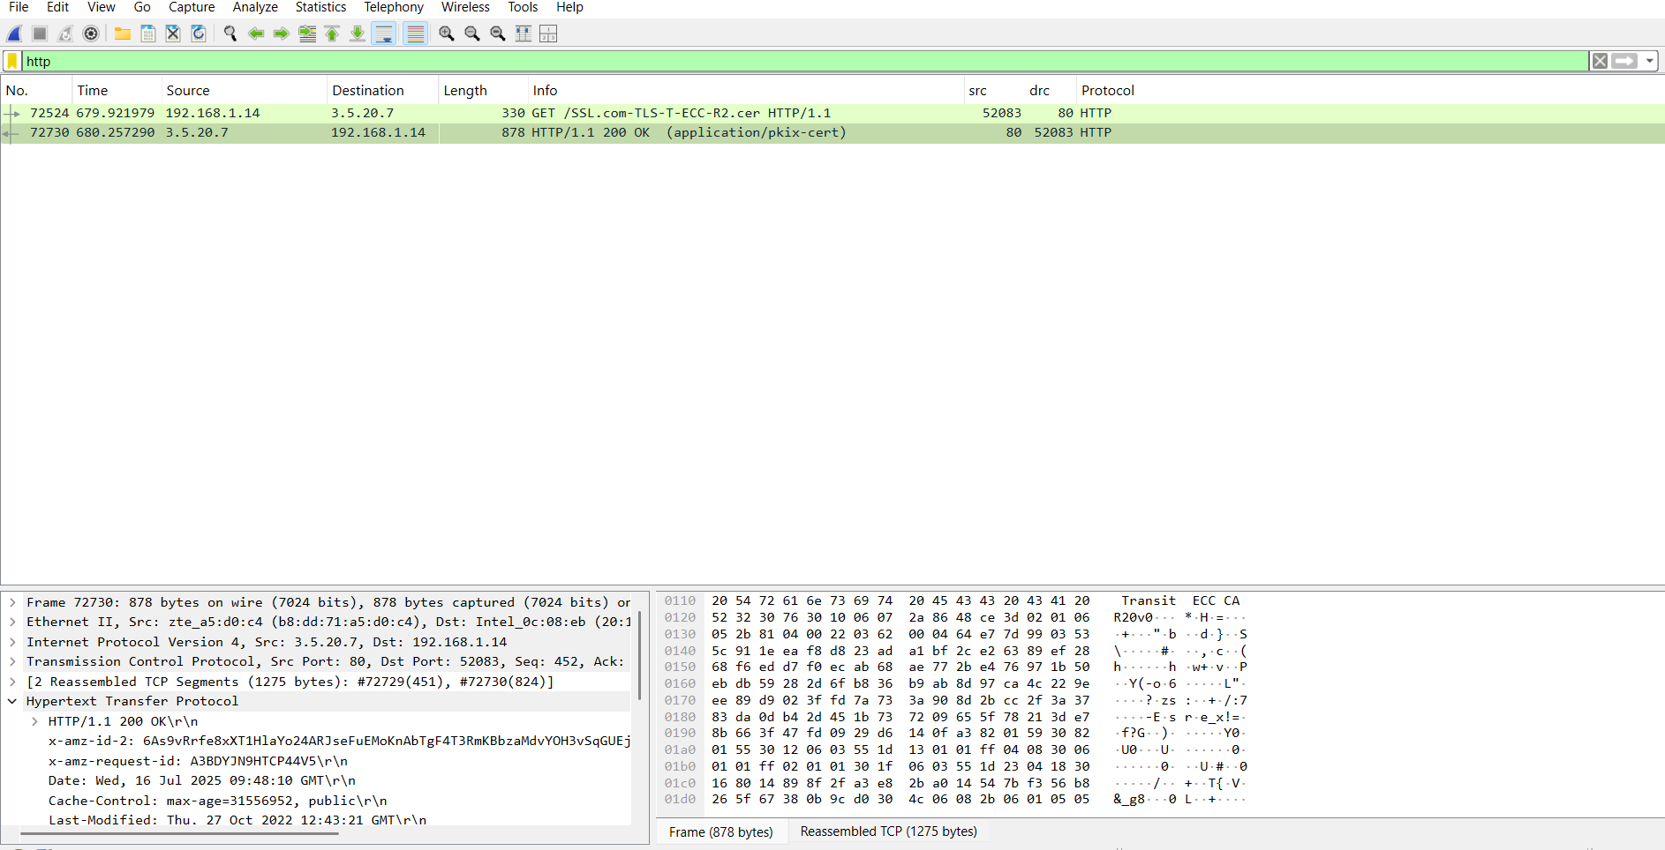
HTTP Capture

Slide 18
Exercise 3: Analyze HTTP Requests
Steps
In the filtered HTTP traffic, locate an HTTP GET request.
Click on the GET request to view its details in the packet details pane.
Expand the "Hypertext Transfer Protocol" section to see detailed information about the request, such as the requested URL, headers, and parameters.
Expected Output
Detailed information about an HTTP GET request displayed.

Slide 19
Exercise 4: Analyze HTTP Responses
Steps
In the filtered HTTP traffic, locate the corresponding HTTP response for the GET request you analyzed.
Click on the response to view its details in the packet details pane.
Expand the "Hypertext Transfer Protocol" section to see detailed information about the response, such as the status code, headers, and content type.
Expected Output
Detailed information about an HTTP response displayed.

Slide 20
Conclusion of above exercises
By completing these exercises, you have learned how to capture, filter, and analyze HTTP traffic using Wireshark. These skills are essential for understanding web communication, troubleshooting network issues, and performing security investigations.

Slide 21
Detecting and Investigating Malware Traffic
Introduction
In this project, you'll learn how to use Wireshark to detect and investigate malware traffic. Identifying malicious network behavior is crucial for protecting networks and responding to security incidents.
Pre-requisites
Basic understanding of networking concepts
Wireshark installed on your computer
A sample PCAP file containing malware traffic (e.g., from Malware Traffic Analysis)

Slide 22
Lab Set-up and Tools
Wireshark: Download and install Wireshark from https://www.wireshark.org/download.html.
Sample PCAP File: Download a sample PCAP file containing malware traffic for analysis.
Link to download PCAP files : https://malware-traffic-analysis.net/2022/workshop/index.html
Link for malware analysis : https://malware-traffic-analysis.net/

Slide 23
Exercises
Exercise 1: Load a Sample PCAP File
Steps
Open Wireshark.
Go to "File" > "Open" and select the sample PCAP file you downloaded.
The file will load, and the captured traffic will be displayed.
Expected Output
The sample PCAP file containing network traffic loaded in Wireshark.

Slide 24
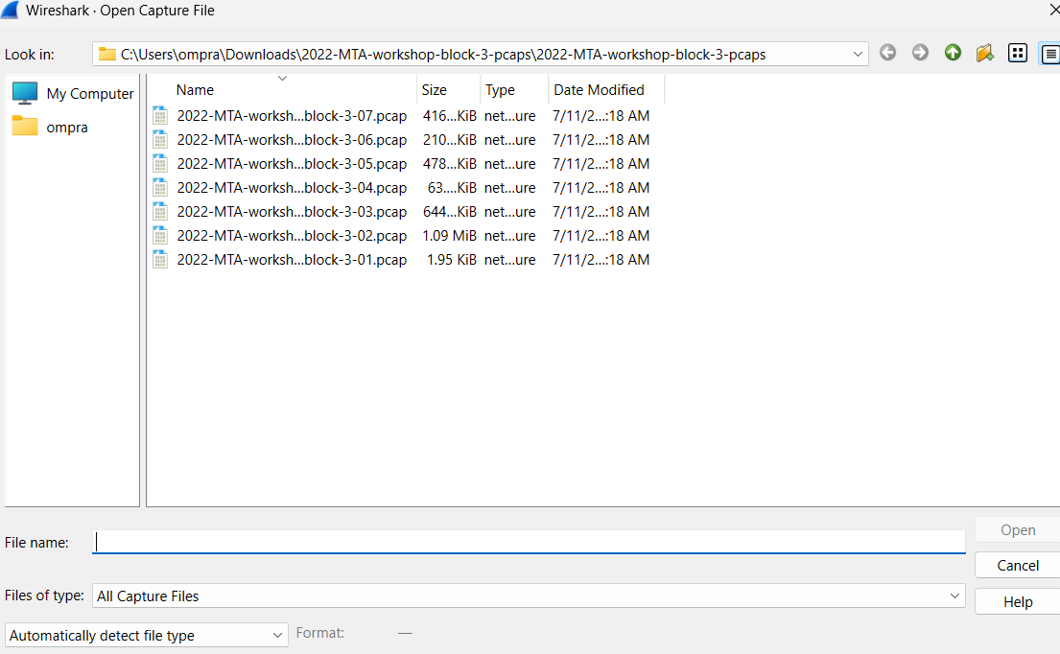
Pcap Files

Slide 25
Exercise 2: Identify Malicious Traffic Patterns
Steps
Look for unusual patterns in the traffic, such as repeated connections to suspicious IP addresses, unusual protocol, or large amount of data being transferred.
2. Use the filter bar to isolate suspicious traffic. Common filters include:
-> IP .Add == x.x.x.x. (replace x.x.x.x with a suspicious IP address)
-> TCP .port === 4444 (common port used by malware)
-> HTTP . Request (to view HTTP request that might indicate command- and-control activity) .Expected Output
Suspicious traffic patterns identified in the network capture.

Slide 26
Exercise 3: Analyze Malicious Traffic
Steps
Select a packet that appears suspicious based on your initial analysis or it seems to be different from others protocols.
Click on the packet to view its details in the packet details pane.
Expand the relevant protocol sections to examine the details of the packet, such as headers, payload data, and any anomalies.
Expected Output
Detailed information about a suspicious packet analyzed.

Slide 27
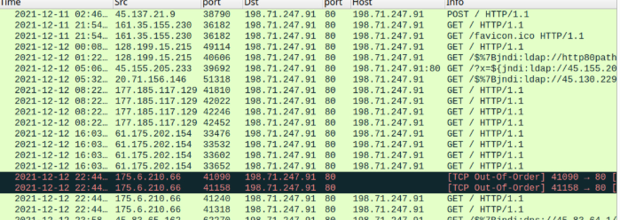
Malicious Files

Slide 28
Exercise 4: Follow the Malware's Communication Stream
Steps
Right-click on a suspicious packet and select "Follow" > "TCP Stream" or "UDP Stream" to view the entire conversation.
Analyze the conversation for indicators of malicious activity, such as unusual commands, encoded data, or unexpected file transfers.
Expected Output
A complete communication stream of the malware analyzed.

Slide 29
Exercise 5: Document and Report Findings
Steps
Take notes on the suspicious activities and patterns you identified in the traffic.
Document key findings, including IP addresses, ports, payload data, and any other relevant details.
Summarize your findings in a report format, which can be used for further investigation or as part of a security incident report.
Expected Output
A detailed report documenting the findings from your malware traffic analysis.

Slide 30
Conclusion of above exercises
By completing these exercises, you have learned how to detect and investigate malware traffic using Wireshark. These skills are essential for identifying malicious network behavior, responding to security incidents, and protecting network infrastructure.

Slide 31
Results and Discussion
Results:
After capturing and analyzing network traffic using Wireshark and Zeek, we made the following observations:
Detected several unusual DNS queries that pointed to unknown or suspicious domains.
Identified multiple unauthorized remote login attempts within the test network.
Noticed abnormal traffic spikes at certain times, indicating possible scanning activities or malware communication attempts.
Zeek generated detailed logs showing connection attempts, HTTP requests, DNS queries, and SSL usage, while Wireshark provided in-depth packet details for further inspection.

Slide 32
Discussion:
These findings show how combining Wireshark and Zeek improves network monitoring. The suspicious DNS queries might indicate malware trying to contact external servers. Unauthorized login attempts are signs of possible hacking or brute-force attacks. Abnormal traffic spikes could mean someone is scanning the network for weaknesses.
By using both tools, we could not only detect these activities but also understand when, how, and where they happened. This makes it easier for network administrators to take quick action and improve security

Slide 33
Challenges:
Large volume of data: Capturing and analyzing big amounts of network traffic required good filtering skills and careful analysis.
Interpreting logs: Zeek produces a lot of log files, which were sometimes difficult to interpret for specific attack patterns without experience.
Setting up test environments: Creating controlled scenarios for testing attacks or unusual activities without affecting other systems was challenging.

Slide 34
Conclusion
In this project, we aimed to detect unusual or suspicious activities in network traffic using Wireshark and Zeek. Yes, our project successfully solved the problem we aimed to address. By combining both tools, we were able to monitor network traffic, capture data packets, and identify possible security threats like unauthorized login attempts, suspicious DNS queries, and abnormal traffic spikes.
From this project, we learned how to capture and analyze real network traffic, how to interpret logs and packet data, and how to spot warning signs of potential attacks. We also gained hands-on experience with two important cybersecurity tools and better understood the challenges of monitoring and securing a network in real time.

Slide 35
Future Work:
If we had more time, we would:
Set up a larger and more realistic network environment to analyze more complex traffic patterns.
Add machine learning techniques to automatically detect anomalies in the logs.
Improve encryption handling by integrating SSL decryption for deeper traffic inspection (in a legal and controlled environment).
Create a dashboard to visualize network activity for easier monitoring.

Slide 36
References
Wireshark Foundation. (2024). Wireshark User Guide. Retrieved from: https://www.wireshark.org/docs/wsug_html_chunked/
The Zeek Project. (2024). Zeek Documentation. Retrieved from: https://docs.zeek.org/en/current/
Bejtlich, R. (2014). The Practice of Network Security Monitoring: Understanding Incident Detection and Response. No Starch Press.
Scarfone, K., & Mell, P. (2007). Guide to Intrusion Detection and Prevention Systems (IDPS). NIST Special Publication 800-94. Retrieved from: https://csrc.nist.gov/publications/detail/sp/800-94/archive/2007-02-01
Conti, G. (2007). Security Data Visualization: Graphical Techniques for Network Analysis. No Starch Press.

